Slide 1
Introduction to Computer Hardware (CMP213) Digital Computers
Egena Onu, Ph.D.

Slide 2
Registers
Registers are special transistors that store data and instructions as they are been manipulated by the control unit and ALU.
Registers are essentially extremely fast memory locations within the CPU that are used to create and store the results of the CPU operations.
Every data to be processed by CPU must be in the registers.
Essentially, registers are the memory locations to which data are sent and retrieved.
Different computers have different register sets.
Computers differs from one another in the number of registers, register types, and the length of each register.
They also differ in the usage of each register.
General purpose registers are used for multiple purposes as assigned a variety of functions by programmers.

Slide 3
Types of Data
Some registers are user visible and modifiable. Others are not.
User visible and modifiable registers:
General purpose
Data (e.g accumulators
Address (e.g., base addressing, index addressing)
Control registers (not visible to users)
Program Counter (PC)
Instruction Decoding Register (IR)
Memory Address Registers (MAR)
Memory Buffer Registers (MBR)
State registers (visible to the user but not directly modifiable)
Program Status Word (PSW)

Slide 4
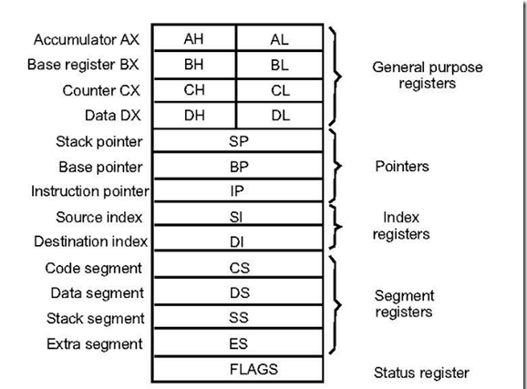
Type of Registers

Slide 5
Type of Register
There are many types of registers abound, depending, especially on the purpose for which they are built.
However, in this class, we will look at:
Memory Access Registers (MAR)
Instruction Fetching Registers
Condition Registers and
Special Address Registers

Slide 6
Type of Registers
Memory Access Registers (MAR)
To perform write and read operations, two registers are essential.
These registers include:
Memory Data Register (MDR) and
Memory Access Register (MAR)
The MDR and MAR are used exclusively by the CPU and are not directly accessible to programmer.

Slide 7
Type of Registers
Memory Access Registers (MAR)
In order to perform a write operation into a specified memory location, the MDR and MAR are used as follows:
The word to be stored into the memory location is first loaded by the CPU into MDR.
The Address of the location into which the word is to be stored is loaded by the CPU into the MAR.
A write signal is then issued by the CPU.

Slide 8
Type of Registers
Memory Access Registers (MAR)
Similarly, to perform a memory read operation, the MDR and MAR are used as follows:
The address of the location from which the word is to be read is loaded into the MAR.
A read signal is issued by the CPU.
The required word is then loaded by the memory into the MDR and ready for use by the CPU.

Slide 9
Types of Registers
Instruction Fetching Registers
In order to fetch an instruction for execution, two registers are used. These are:
Program Counter (PC)
The PC is contains the address of the next instruction to be fetched.
After a successful fetch, the PC is updated to point to the next instruction to be executed.
In the case of a branch operation, the PC is updated to point to the branch target instruction after the branch is resolved.
Instruction Register (IR)
The fetched instruction is loaded in the IR for execution.

Slide 10
Type of Registers
Condition Registers
Condition registers/flags are used to maintain status information.
Some architectures contain a special program status word (PSW).
The PSW contains bits that are set by the CPU to indicate the current status of an executing program.
These indicators are typically for:
Arithmetic operations
Interrupts
Memory protection information or
Processor status.

Slide 11
Memory
In a computer, memory refers to devices that can store information temporarily or permanently.
A computer needs storage devices to operate. Some of the major devices are: HDD, CD ROM, RAM, Floppy Disk etc.

Slide 12
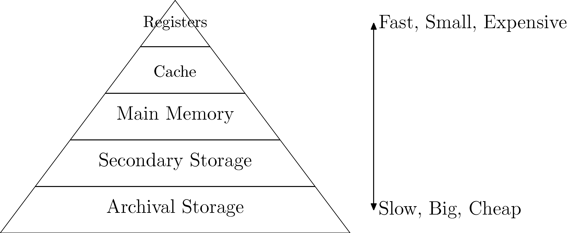
Memory Hierarchy
In a conventional digital computer, memory is organised in a hierarchy as shown in the figure below.
If we put aside the set of CPU registers then a typical memory hierarchy starts with a small, expensive, and relatively fast unit called the cache.

Slide 13
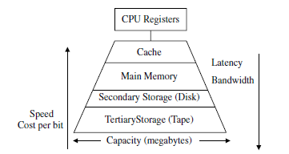
Memory Hierarchy
With the registers removed from the hierarchy, a typical memory hierarchy would look like:

Slide 14
Memory Hierarchy
The point of memory hierarchy in itself is an engineering trade-off:
Cost and volume
versus
Speed and capacity
For a given point in time, increased speed and capacity require greater cost and volume

Slide 15
Memory Hierarchy
The memory hierarchy can be characterised using a number of parameters:
Access type
Capacity
Cycle time
Latency
Bandwidth and
Cost

Slide 16
Memory Hierarchy
Access refers to the actions that physically takes place during a read/write operation.
Capacity of a memory is the amount of data it can hold at anyone given time and it is measured in bytes.
Cycle time is the time that elapsed from the start of a read operation to the time of a subsequent read.
Latency is the time interval between the request for information and the access to the first bit of that information.
Bandwidth is a measure of the number of bits that can be accessed from the memory in a given time and it measured in bits per second (BS).
Cost: the cost of a memory level is usually specified as dollars per megabytes.
Notes:
The term random access refers to the fact that any access to any memory location
takes the same fixed amount of time regardless of the actual memory location and/or
the sequence of accesses that takes place. For example, if a write operation to
memory location 100 takes 15 ns and if this operation is followed by a read operation
to memory location 3000, then the latter operation will also take 15 ns. This
is to be compared to sequential access in which if access to location 100 takes
500 ns, and if a consecutive access to location 101 takes 505 ns, then it is expected
that an access to location 300 may take 1500 ns. This is because the memory has to
cycle through locations 100 to 300, with each location requiring 5 ns.

Slide 17
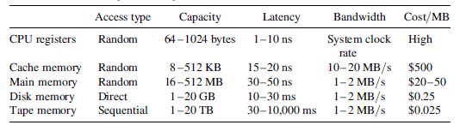
Memory Hierarchy
Parameters of the memory hierarchy are summarised in the table below:

Slide 18
Cache
Very high speed semiconductor memory.
It speeds up the CPU.
Holds frequently used parts of data and program.
Acts as a buffer between main memory and the CPU.

Slide 19
Cache
Advantages
Cache memory is faster than main memory.
It consumes less access time as compared to main memory.
It stores the program that can be executed within a short period of time.
It stores data for temporary use.
Disadvantages
Cache memory has limited capacity.
It is very expensive.

Slide 20
Main Memory
Holds data and instructions running at the moment in the CPU.
Its has limited space.
Data is lost when power is turned off.
Not as fast as registers and Cache.
Some common types are: RAM and ROM.
ROM: EPROM, EEPROM.
RAM: SIMM, DIMM, RIMM, SO-DIMM, SO-RIMM, RDRAM, SDRAM…....

Slide 21
Main Memory
Characteristics:
Semiconductor memories
It is known as the primary memory.
Usually volatile memory.
Data is lost in case power is switched off.
It is the working memory of the computer.
Faster than secondary memories.
A computer cannot run without primary memory.

Slide 22
Secondary Memory
Slower than main memory
Stores data and information permanently
External memory and non-volatile
It is not directly accessed by the CPU
Contents are first of all transferred to main memory before the CPU has access to them

Slide 23
Characteristics
These are magnetic and optical memories
It is known as backup memory.
It is non-volatile memory.
Data is permanently stored even if power is switched off.
It is used for storage of data in a computer.
Computer may run without secondary memory.
Slower than primary memories.

Slide 24
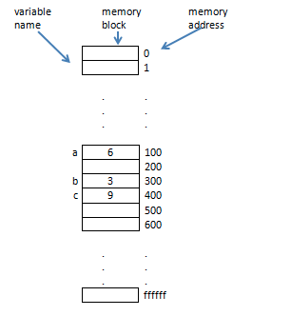
Memory Blocks

Slide 25
Address Translation
Relocation
Protection
Convert virtual addresses to physical addresses
Needs to be fast: done in hardware
Segmentation: variable size memory blocks
Paging: fixed size memory blocks
Both are related to memory management schemes

Slide 26
Memory Allocation Techniques
Free bit map:
Good for fixed-sized blocks, like pages
Low overhead
Free list:
Sometimes tree or hash table
Standard trick: store overhead structures in free blocks themselves

Slide 27

Free Bit Map
One bit for each block:
1 for free, 0 for allocated

Slide 28
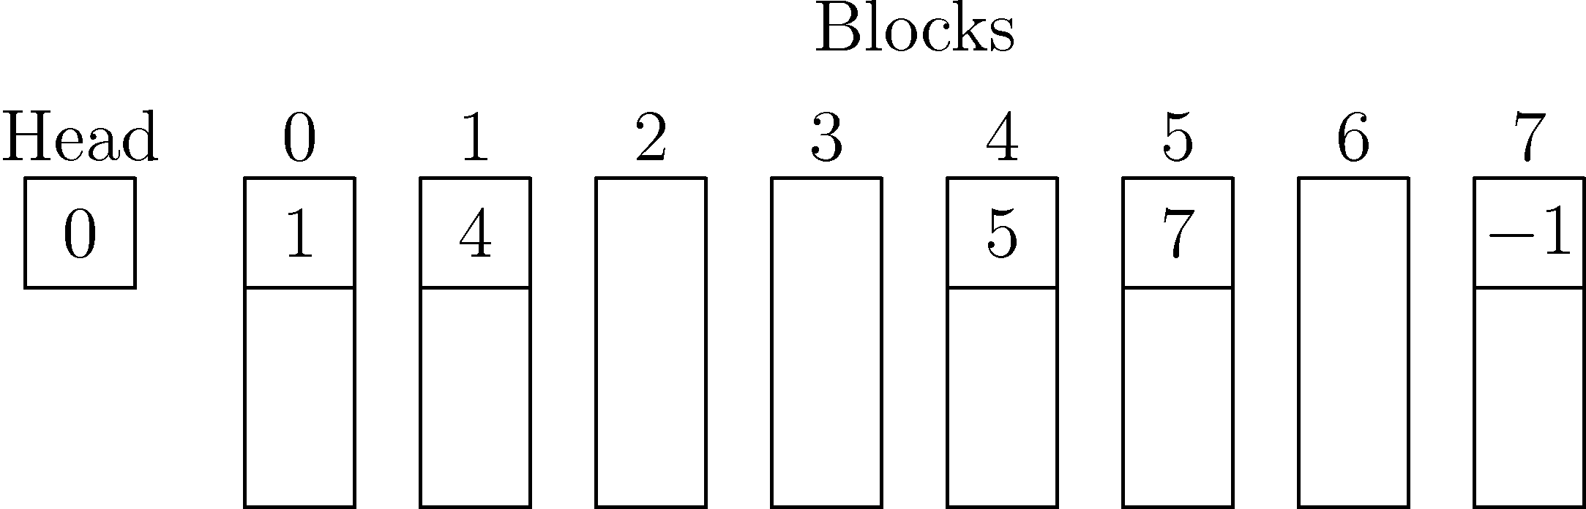
Free Linked List
Each free block points to the next
Pointers stored in the free blocks

Slide 29
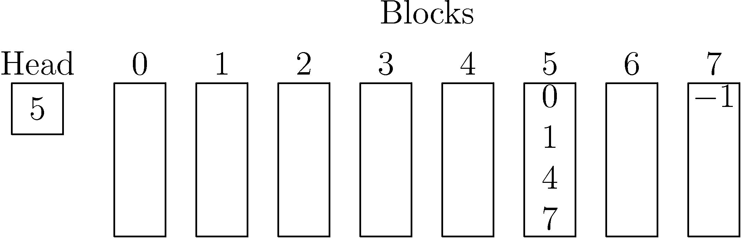
Free List Array
Array of free block number
Divided into segments the size of a block

Slide 30
Fragmentation
External fragmentation: wasted space outside allocation units.
Internal fragmentation: wasted space within allocation units.

Slide 31
Variable-Sized Allocation
Among free blocks at least as large as the request:
First fit: pick the first
Next fit: pick the next
Best fit: pick the smallest
Worst fit: pick the biggest

